Slide 1
Yurt Games
(Name might be changed later…)
Savaş Çoruh – Project Lead & Developer
Zafer Çoruh – Lead Sound Designer & Developer
Kürşat Çakmak – Lead Designer

Slide 2
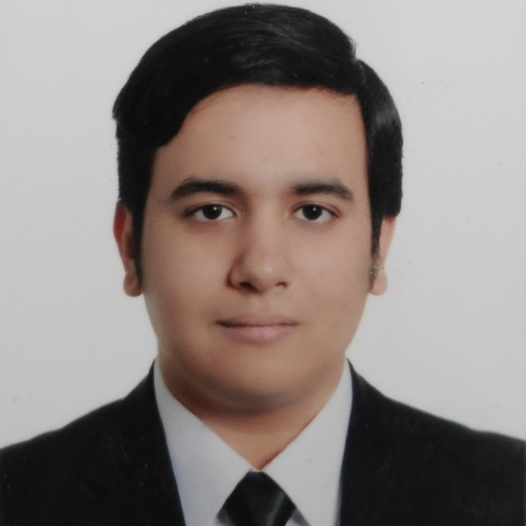
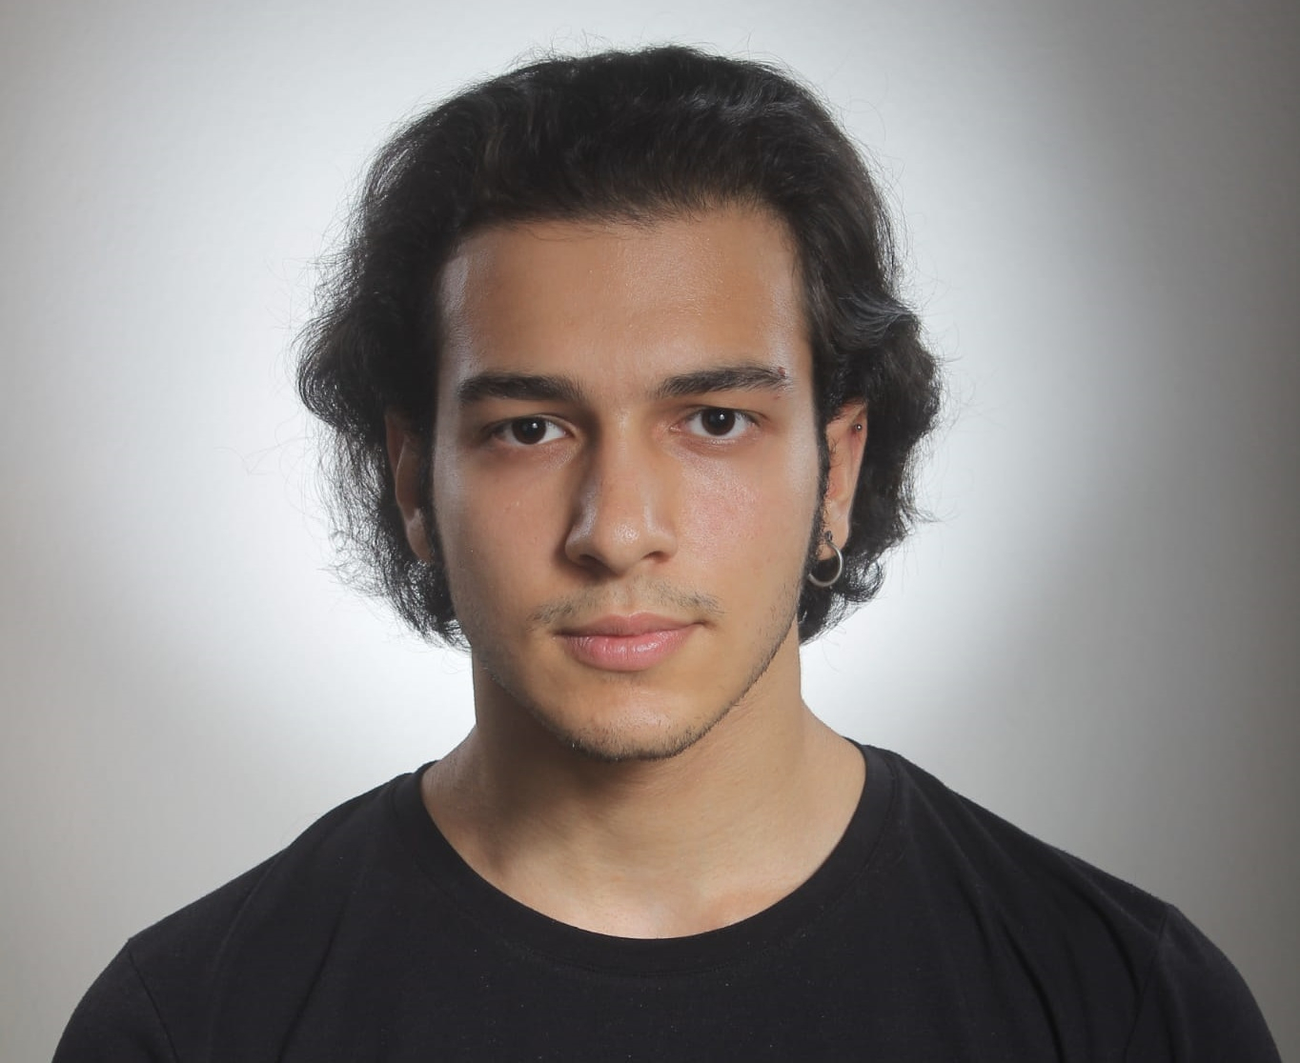
Game Team
Savaş Çoruh
Zafer Çoruh
Kürşat Çakmak
Project Lead & Developer
Leadership, management, GitHub, Unity and C#
Lead Sound Designer & Developer
FL Studio, Unity and C#
Lead Designer
2D and 3D design, texture, modelling, animation, particle effects, Unreal Engine and Blender

Slide 3
Game Team
Savaş Çoruh
I was born in İstanbul in the year 1996. As a 25 years old team leader I had a chance to work with many freelancer teams for game localization and game press in the past where I got experienced as a project leader and editor. For the last couple of years I have started to learn mobile game development both in theory and in practice. I know C# language as intermediate level -but I’m developing myself to get into upper-intermediate level- and I can use the latest version of Unity game engine as well.
I have learnt using Unity and C# on Udemy from courses made by Rick Davidson and GameDev.tv Team. I had this "game producer" dream since my childhood and I am proud to say that it is time to bring this dream into reality. One of our team members is my brother and the other is my friend whom I trust both. Together, we will convert our imagination into games.
Leadership, management, GitHub, Unity and C#

Slide 4
Game Team
Zafer Çoruh
I was born in 1999, in İstanbul. In this short journey, I had the chance to enter coding universe in my high school years. I studied in a vocational high school in the field of database programming. I have been using C# and MsSQL, and I was an intern in New Bilişim Teknolojileri for five months. There, I had chance to work (specifically) on their software solution called enCRM. Even though I always wanted to design games with my brother, I was happy as long as I was coding.
I had to put my programming career on hold due to change of field for the last couple years, but thanks to my brother's never-ending motivation speeches and Rick Davidson's C#/Unity Engine courses, we are only one step away from our dreams coming true.
FL Studio, Unity and C#

Slide 5
Game Team
Kürşat Çakmak
Born in Amasya in 1992, I was always involved in modeling, or any field which revolves around art. I have 6 years of art director experience and trying to develop my own game in my free times. Every model and asset is being made by me using Blender and combining it with Unreal Engine. So, aside from being an art director, I am also expert on 3D modeling and advertising design. I also got game designing education from Anima Okul in Beşiktaş.
"How can I move the hyper casual industry forward in Turkey in a better way?" With this goal, I try to make my designs a little more effective and worked on, as well as adding something from myself to these games in order to put my signature.
2D and 3D design, texture, modelling, animation, particle effects, Unreal Engine and Blender

Slide 6

Why do you want to join oFON?
• To contribute and be a part of the ecosystem; develop our games, skills, ideas, and friendships.

Slide 7
Why you?
Why not? We are dynamic and young quick learners who are eager to take part in production. We are gamers but we are also consumers, and that needs to change; we should start producing asap!

Slide 8
Our Game Production Process
We start brainstorming when we meet. That room or Discord channel is where the magic happens. As soon as we create an idea or two (or even more!) we develop that as an imaginary project, and then we start taking notes from there to start our project for development in real life.

Slide 9
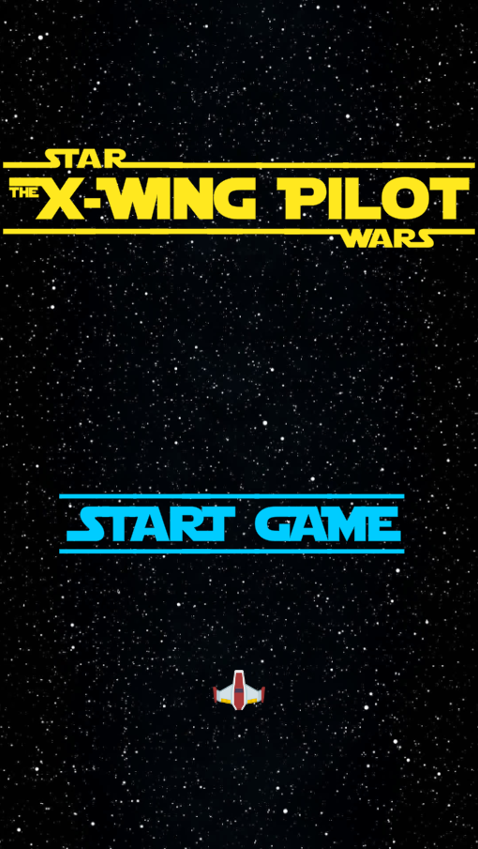
Star Wars: The X-Wing Pilot
This is our first mobile game which we have developed not to publish, but to play in our own phones. It is a Space Invaders or Asteroids like retro game developed in today's 2D technology in Unity and it is by far the best star pilot game in the Star Wars universe made for mobile.
We have used assets from Kenney.nl, music and SFX from the movies, and the rest is our own style. The real purpose of making this game was the Udemy course which we have attended. Then this idea grew and we said let's make this game to show our talent for our future publisher. Of course it is not intended for publishing because we don't own its rights, but we can always change some stuff to make it a whole new game. Yet we have other ideas that fits to hyper casual genre.

Slide 10
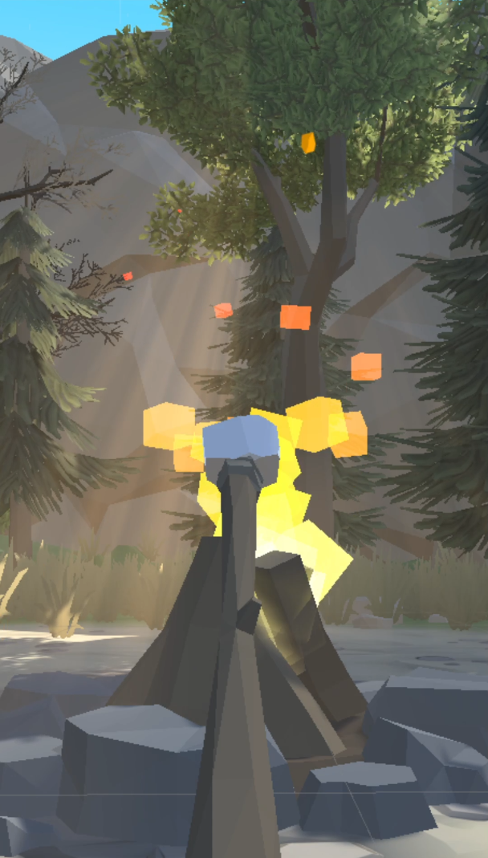
Marshmallow Game
This may be the best idea that we currently have. Our designer friend has made all the assets we need and created a beautiful demo scene in order to show you. We are planning to start developing our prototypes from this idea which is likely to become the next big thing!
Core mechanics of this game is you control the branch on the y-axis and rotate it on the x-axis to cook the marshmallow. Atmosphere is like camping, beautiful and calming. There will be various backgrounds like day and night, different cooking sources like cooktop in the kitchen etc. All you have to do is to cook the perfect marshmallow, but of course you can burn it which will give you less rewards with a bad result. Each level has its different atmosphere, various number of marshmallows on the stick, and relaxing experience. We can use skins for the stick to change it to a sword or even shish kebab where you cook meat or tomato and pepper.

Slide 11
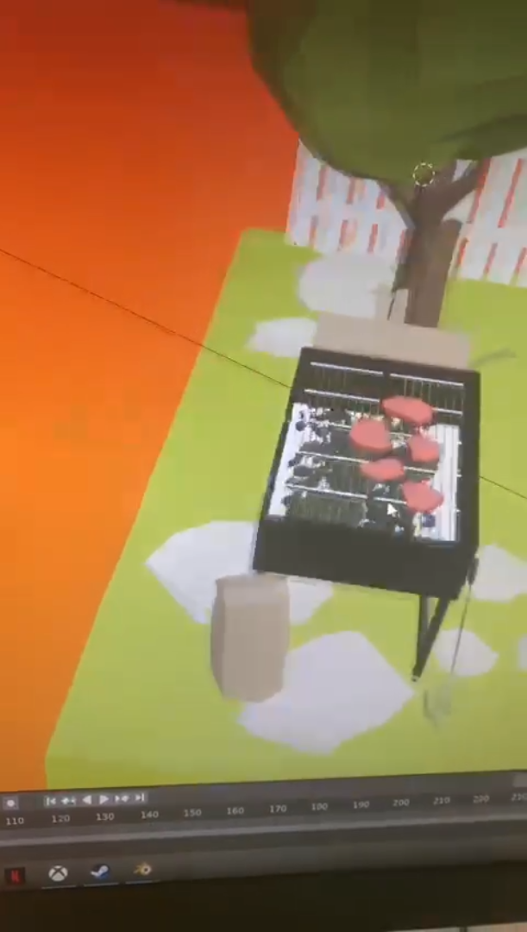
BBQ Game
Just like our “Marshmallow Game” this is yet another cooking style game with barbecue. Players will have good time cooking meat for hamburgers, or sausages for hot dogs, or both at the same time!
Different from the previous game, here you don’t use a stick on X and Y axis to control your cooking skills. You will drag and drop what you will cook from the given table for that level. Also, different meats or food will take different times to cook for each side. But every level will not take longer than a minute or two. Just like in Marshmallow Game, you also need to be sure that you don’t burn the ingredients while relaxing in a beautiful atmosphere like your backyard or nature.
(Sorry for low quality screenshot, we have added this slide in the last minute.)

Slide 12
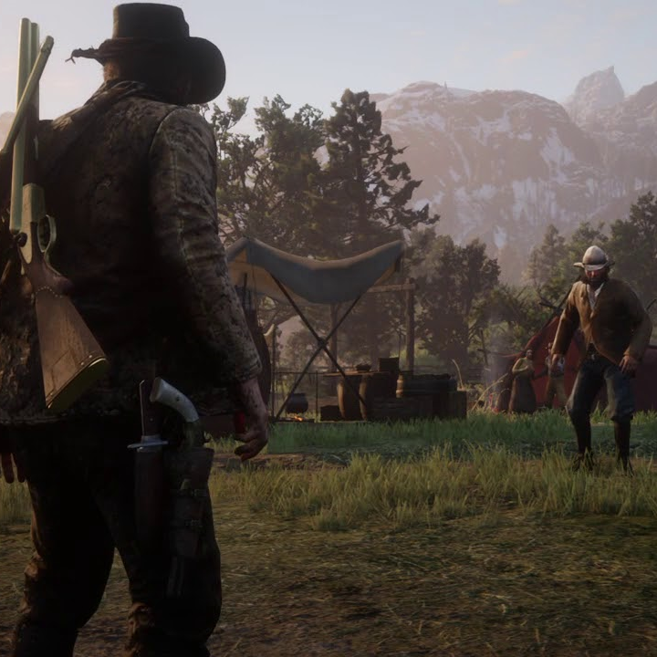
Duelling Cowboys Game
Another idea has came when we were playing Red Dead Online. The main idea of this game is to shoot your opponent as quick as Lucky Luke or Red Kit in Turkish. That opponent can be A.I. or better yet, another player. This is still in theory phase.
The mechanics would be two phased for the shooting. First, you need to draw your weapon by clicking at the right time on screen. There could be an indicator going up and down continuously to show you when you will quickdraw or not. Then you will have a short window of time to select where on the opponent you will choose to aim and how many times you will shoot. If it’s A.I. then some of the enemies could be defeated with only one headshot. Tougher enemies like bosses may need more than one shot but you can only select one body part per bullet and you have 6 rounds in your good old Colt 1851.
(Screenshot taken from Red Dead Online.)

Slide 13
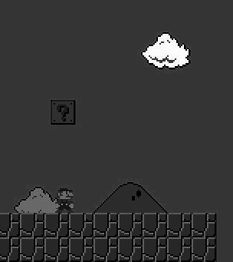
Many, Many More!
We are brainstorming anytime and getting inspiration from anywhere! When we start making our games, numerous ideas will be thrown to the trash can, yet many more will take their place. For example…

Slide 14
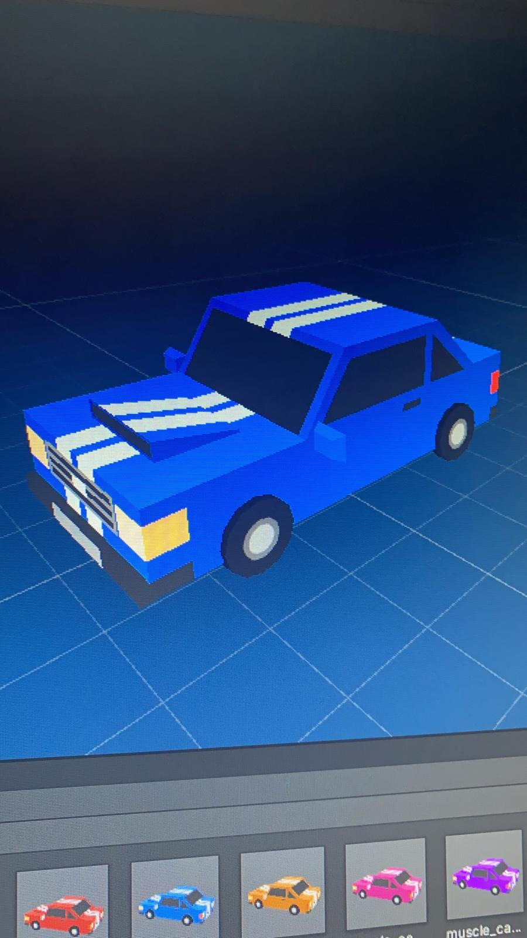
Hot Wheels Style Game
With different tracks for each level and cool cars to unlock by earning $$$ which is doubled or sometimes tripled by watching ads.

Slide 15
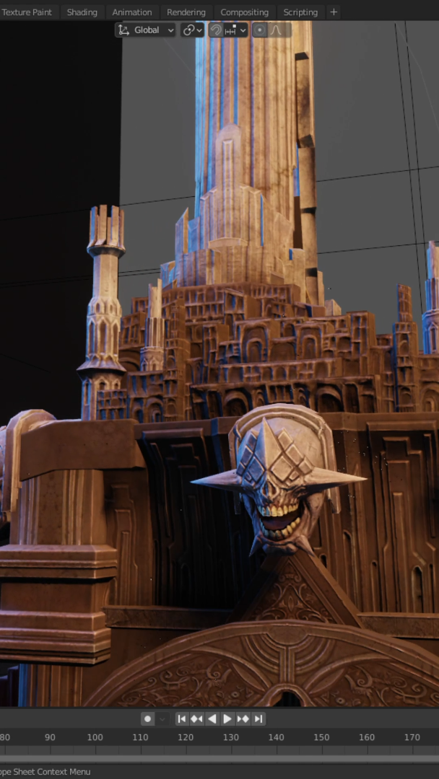
Uhh… wrong slide!
But yes, our designer Kürşat Çakmak made this beauty. Savaş Çoruh named this: “The Palace of Eternal Torture”

Slide 16
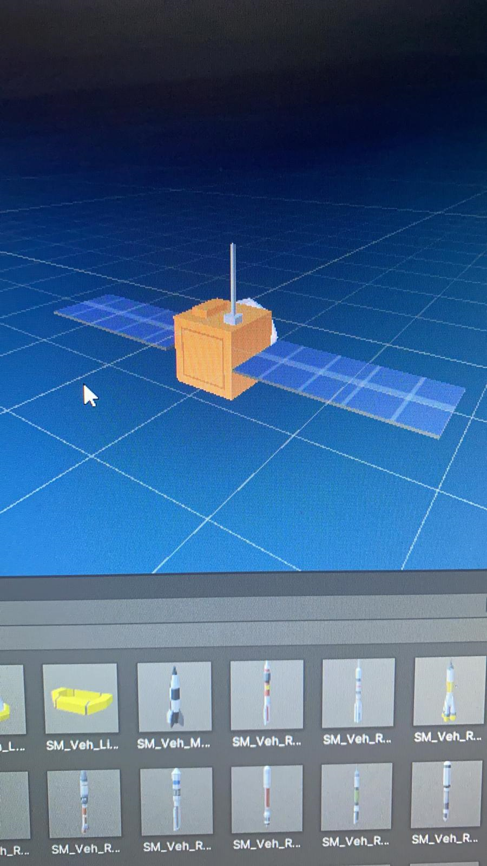
Space! Game
Almost every asset for this game is already ready. We just need to use our creativity to make it a game.

Slide 17
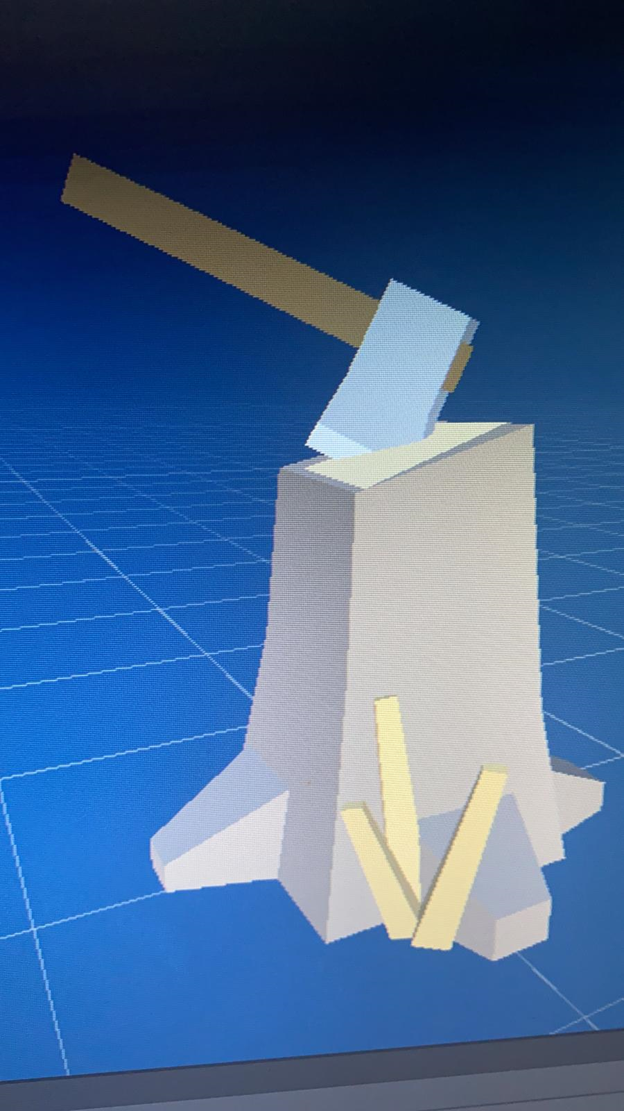
Woodcutter Game
And many games like these.

Slide 18
Our Vision
We want to become a unicorn, simple as that. But we don’t plan our exit just yet, because we might even not exit. Our dream is to convert our team into a company to find young talents like us and give them a professional learning environment to help them build their career, and to contribute the ecosystem as well as our country, become a reliable company that makes our dreams come true.

Slide 19
Your Expense Statement
Currently we are unemployed, except our designer Kürşat who works as a freelancer living in İstanbul. We all want this job to be our “only” job and move from Aydın to İstanbul to unite our team. For that, our expenses are rents, bills (most importantly electricty and internet), and food. Aside from these personal expenses, there are also the expenses of our future company.

Slide 20
Personal Expenses
Estimated monthly costs of a single person are $450 without rent. Rents are around $700 or $1,000 currently in İstanbul. Average of these would be $1,300 for a single team member. Therefore, we would like to earn at least $2,000 (each member) monthly. That makes $72,000 combined for three of us annually.

Slide 21
Office Expenses
We are planning to start as an “online office” and see if we can continue like that until we publish a hit game and start hiring. Then we will need an office, but these expenses can be dealt with from our percentage as a company from the income. Any additional funding here would support us to hire one or two more team members before we move into our office at the early stage.

Slide 22
Equipment & Software
We would like to work on MacBooks as any good developer. But our own gaming computers and all our equipment are more than enough to start developing. We would like to have our additional computers like MacBook for work when we have an office. Software is a bit tricky. We need to pay Unity $1,800/year per seat when we cross $200K revenue in the last 12 months. Other software like Visual Studio - Professional requires $45 monthly subscription per developer, and FL Studio - Producer Edition requires €189 for one-time purchase. Blender is free.

Slide 23
Last But Not Least
We want to start developing our games in our own company (online or physical) as soon as possible. This could only happen when Rollic and oFON accepts this application because that is the only chance for our team to make wonderful things together. We will keep submitting this application for many times with more additions overtime, per month or even per week if necessary. But we are confident that we will meet with you right after the first time. Let us hope we will build this Yurt in this season of the year.

Slide 24

Contact Info Savaş Çoruh Zafer Çoruh Kürşat Çakmak savascoruh@outlook.com zafercoruh@hotmail.com oberkaizer88@gmail.com +90 539 317 3496 +90 530 650 8534 +90 505 924 1428

